Slide 1
WORK WITH
TEAMREFLECTION
Notes:
Heading: Arial Bold 32pt
Subheading: Arial 20pt

Slide 2
<<Pictures introducing yourself as a trainer>>
<<Tell something about yourself>>
<<also use pictures about your hobbies that show how you handle your stress>>

Slide 3
How are you sitting here?
Notes:
Heading: Arial Bold 28pt
Text: Arial 16pt

Slide 4
The basis of team reflection
Engaging with each other:
Sharing experiences, situations, perceptions and emotions openly and without reproach. With respect for the differences
What is stress and how does it actually work:
what it does to you and what is normal in an abnormal situation
Discuss buddy approach

Slide 5
Target
We hear and see a huge amount coming at you. That was already the case before the corona crisis and this crisis comes on top of it.
We want to help you to recognise what this does to you, how to deal with it and to come up with a system together in which you can better support each other in this.

Slide 6
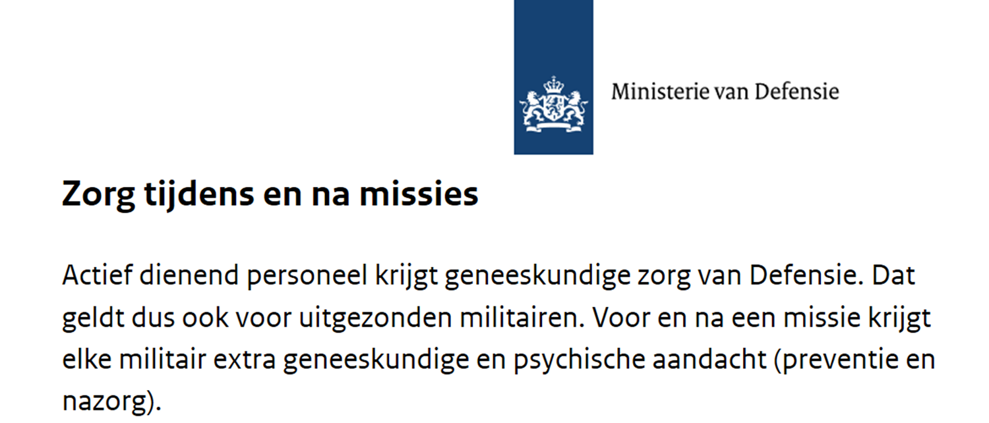

Slide 7
How are you sitting here?
Notes:
Heading: Arial Bold 28pt
Text: Arial 16pt

Slide 8
Not everyone sees the same

Slide 9
Fight or Flight

Slide 13
Regularity
Work towards your sleep
Avoiding naps
Caffeine and alcohol have negative effect
Sunlight

Slide 14
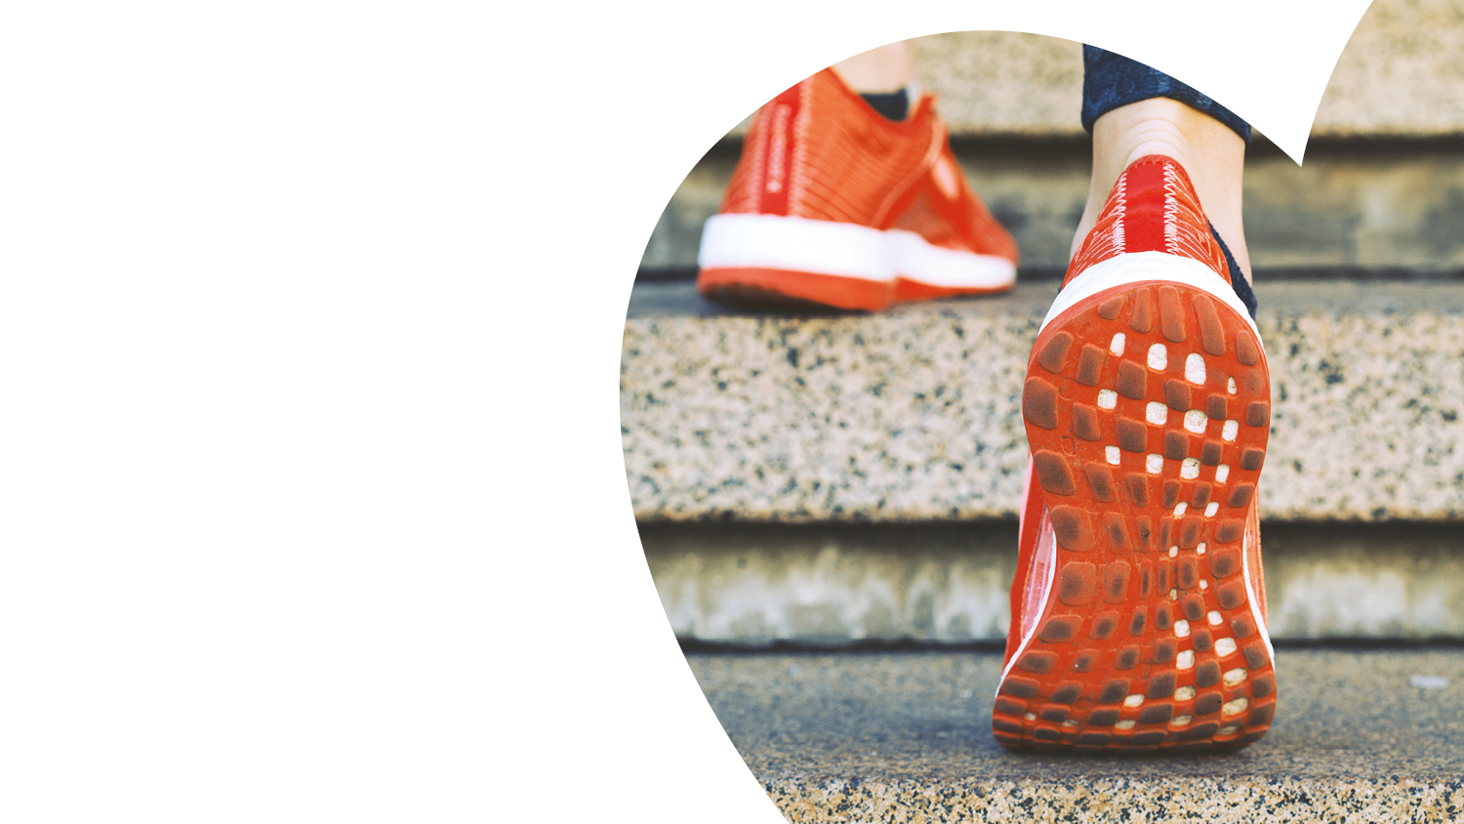
Sufficient exercise during the day
Regular exercise
Healthy food

Slide 15
Seek social support
Organise 'me-time'
Make time for what you love

Slide 16
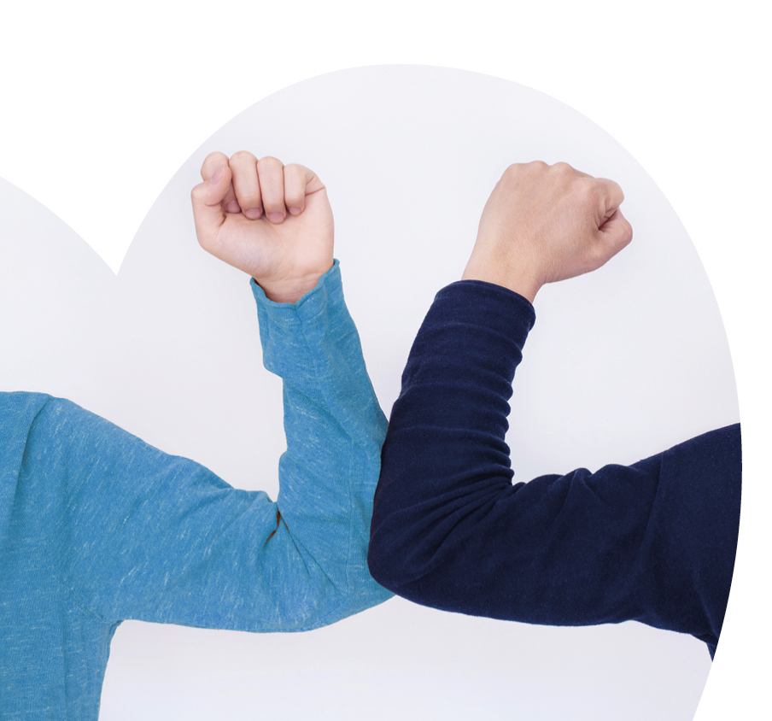
Buddy talks:
Discussing battery scores
What complaints do you recognise (pg 20)
What did you start doing differently?
What can your buddy help you with?

Slide 17
Thank you, stay healthy and keep well

